Slide 1
Queuing system ad performance's

Slide 2
Queuing System
In many real world scenario, queue is prevalent. The problem with the queue is that if it is not managed properly, the customers should wait a long time that causes chaos within the customers. To prevent customer from being unsatisfied with the provided service, queuing system is managed. For eg: During cash withdraw in bank, you have to stay in queue and if it is not managed properly then you will surely be disappointed from the bank service even if that bank is one of the finest one in the city.

Slide 3
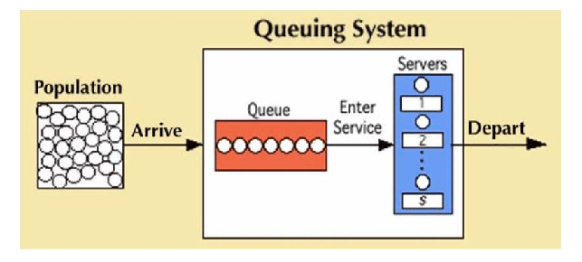

Slide 4
Elements/Characteristics of Queuing System
1. Calling Population: - The population of potential customers of the service is called calling population. - It may be finite or infinite. - The system of the restaurant, bank and so on are considered to be open system i.e. with infinite calling population. - The system of repairing certain number of machines by a service man is considered to be closed system i.e. with finite calling population.
2. Arrival: - The way in which the customers enter into the system is called arrival. - In most of the cases, the arrival of the customer is random, so the inter-arrival between two customers is described by a random distribution of interval known as arrival pattern.

Slide 5
3. Queue: - Queue represents the number of customers that have entered into the system and are waiting for the service. - The customer being serviced is not considered to be in queue. - The two main properties of queue are as follows: a) Maximum Size: - Queue, in practice, is always limited. - Maximum size represents the maximum number of customers that can accommodate in the queue. b) Queue Discipline: - Queue discipline represents the rules in which the customers are inserted or removed to or from the queue. - It can be organized in various ways like FIFO, LIFO, Serve In Random Order(SIRO), Priority Queue, etc.

Slide 6
4. Service time: - Service represents the activity that takes some time and the customers are waiting for. - Service time represents the time needed to provide service to a customer by a server. - Service time may be of constant duration or of random duration.
5. Number of Servers: - Servers represent the entity that provides service to the customer. - A system may consist of single server or multiple servers. - A system with multiple servers is able to provide parallel services to the customers.

Slide 7
Characteristics of queuing systems
Arrival Process
The distribution that determines how the tasks arrives in the system.
Service Process
The distribution that determines the task The distribution that determines the task processing time
Number of Servers
Total number of servers available to process the task

Slide 8
Types of queuing system
- Channel is the number of parallel servers. - Phase is the number of servers in sequence.
- Based on numbers of channel and phase, Queuing system is categorized as: 1. Single Channel Single Phase 2. Multiple Channels Single Phase 3. Single Channel Multiple Phases 4. Multiple Channels Multiple Phases

Slide 9
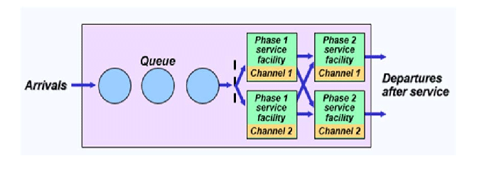

Slide 10
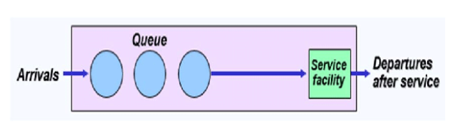
Single Channel Single Phase

Slide 11
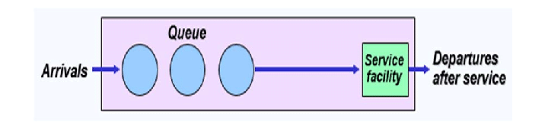
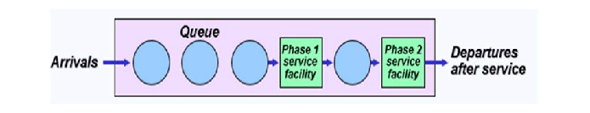
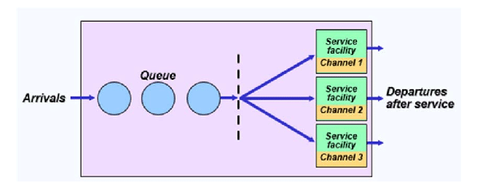

Slide 12
Queueing Notation Kendall Notation 1/2/3(/4/5/6)
Six parameters in shorthand Six parameters in shorthand
First three typically used, unless specified
1. Arrival Distribution
2. Service Distribution
3. Number of servers
4. Total Capacity (infinite if not specified)
5. Population Size (infinite)
6. Service Discipline (FCFS/FIFO)

Slide 13
Kendall Classification of Queuing Systems
The Kendall classification of queuing systems (1953) exists in several The Kendall classification of queuing systems (1953) exists in several modifications.
The most comprehensive classification uses 6 symbols: A/B/s/q/c/p
where:
A is the arrival pattern (distribution of intervals between arrivals).
B is the service pattern (distribution of service duration).
s is the number of servers.
q is the queuing discipline (FIFO, LIFO, ...). Omitted for FIFO or if not specified..
c is the system capacity. Omitted for unlimited queues.
p is the population size (number of possible customers). Omitted for open systems.

Slide 14
Kendall Classification of Queuing Systems
These symbols are used for arrival and service patterns:
M is the Poisson (Markovian) process with exponential distribution of intervals or service duration respectively.
Em is the Erlang distribution of intervals or service duration.
D is the symbol for deterministic (known) arrivals and constant service duration.
G is a general (any) distribution.
GI is a general (any) distribution with independent random values.

Slide 15
Queuing Models
1. M/M/1 Queue
In an M/M/1 queue, customers arrive following a Poisson distribution (random arrival times), and the server provides exponential service times. There is one server and a First-Come-First-Served (FCFS) service rule. This type of queue is also known as an M/M/1/FCFS queue or an M/M/1/FIFO (first-in-first-out) queue.
It is one of the most basic and widely studied queueing models in queuing theory, and it is frequently used as a starting point for understanding the performance of more complex queueing systems. To analyze and evaluate an M/M/1 queue, several performance measures are commonly used. Among them most important measures are:
The average number of customers in the system.
The average waiting time in the queue.
The system utilization.
The probability of a customer finding the server busy.
Example:
The arrival rate of customers is 2 per minute, and the service rate of each server is 3 per minute.

Slide 16
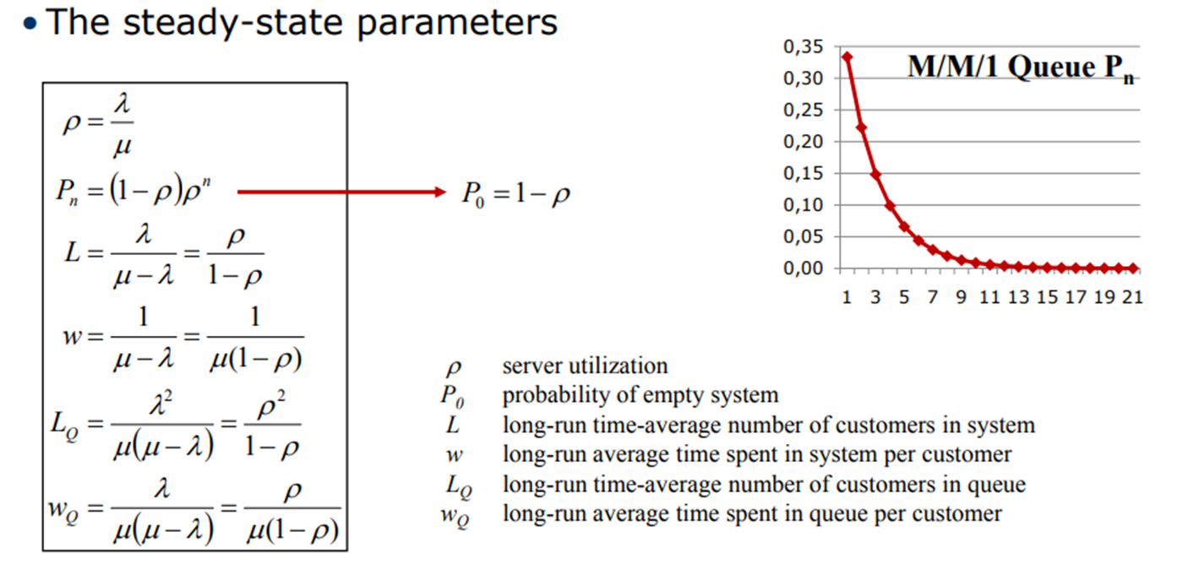
1. M/M/1

Slide 17
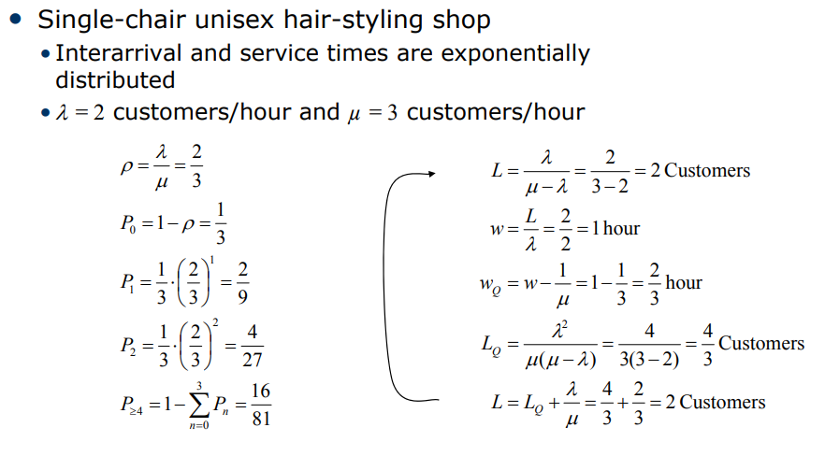

Slide 18
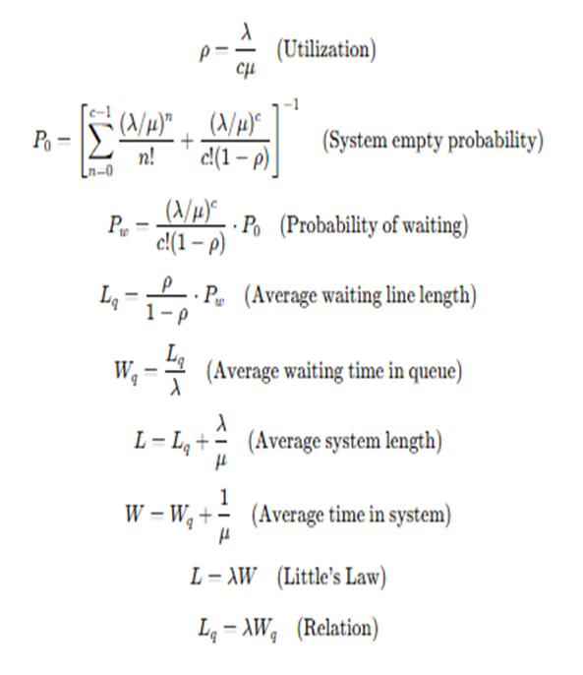
M/M/c Queue
The M/M/c queue is a queuing system where customer arrivals follow a Poisson distribution (M) and service times are exponentially distributed (M). This model is also known as M/M/c/FCFS or M/M/c/FIFO, where FCFS (First-Come-First-Served) denotes the service discipline. The system has c servers, and customers are served concurrently by these servers.
It is also known as the Erlang-c queue. This type of queuing system is useful for simulating situations in which multiple servers provide service. This system's performance metrics are similar to those of the M/M/1 queue. However, some measures are more difficult to calculate because the number of servers c influences the queue's behavior. The most important measures are as follows:
The average number of customers in the system.
The average waiting time in the queue.
The system utilization.
The probability of a customer finding the server busy.
The probability of customers waiting in the queue.
The probability of customers being blocked

Slide 19
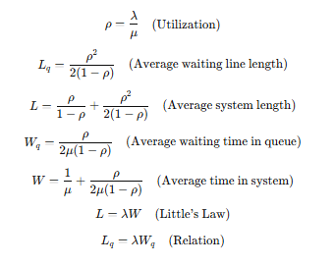
M/D/1
In an M/D/1 queue, the arrival process is Poisson, but service times are deterministic (constant). This means customers are always served in exactly the same time. This is also known as an M/D/1/FCFS or M/D/1/FIFO queue, where FCFS or FIFO denotes the first-come-first-served service discipline. This type of queuing system is useful for simulating situations where customer service times are known in advance and are consistent, such as a carwash service.
The queue will be stable if the arrival rate is less than the service rate, otherwise, it will be unstable due to the deterministic service time. The performance measures for this system are similar to those for the M/M/1 queue, but because the service time is deterministic, closed-form solutions for these measures are frequently easier to obtain. Among the most important measures are:
The average number of customers in the system.
The average waiting time in the queue.
The system utilization.
The probability of a customer finding the server busy.

Slide 20
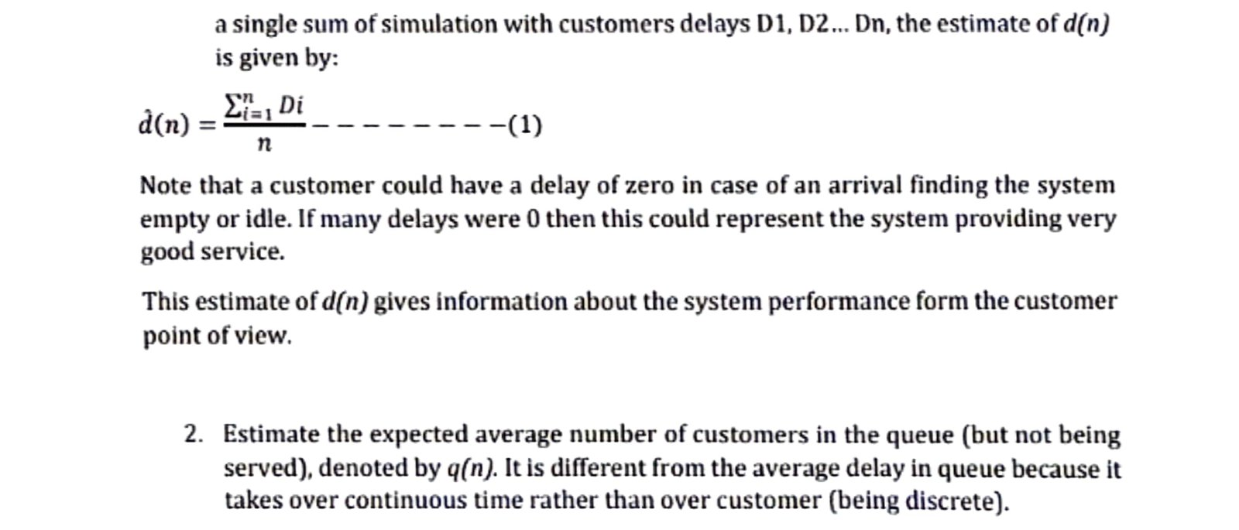
Measuring the Performance of the System:
performance of a queuing system can be evaluated in terms of a number of response parameters, however the following four are generally employed. the following four are generally employed.
1. Average number of customers in the queue or in the system
2. Average waiting time of the customers in the queue or in the system
3. System utilization System utilization
4. The cost of the waiting time & idle time
1. Estimate the expected average delay d(n)in queue of (n)customers. The actual
average delay for n customers depends on the inter arrival and service time.

Slide 21
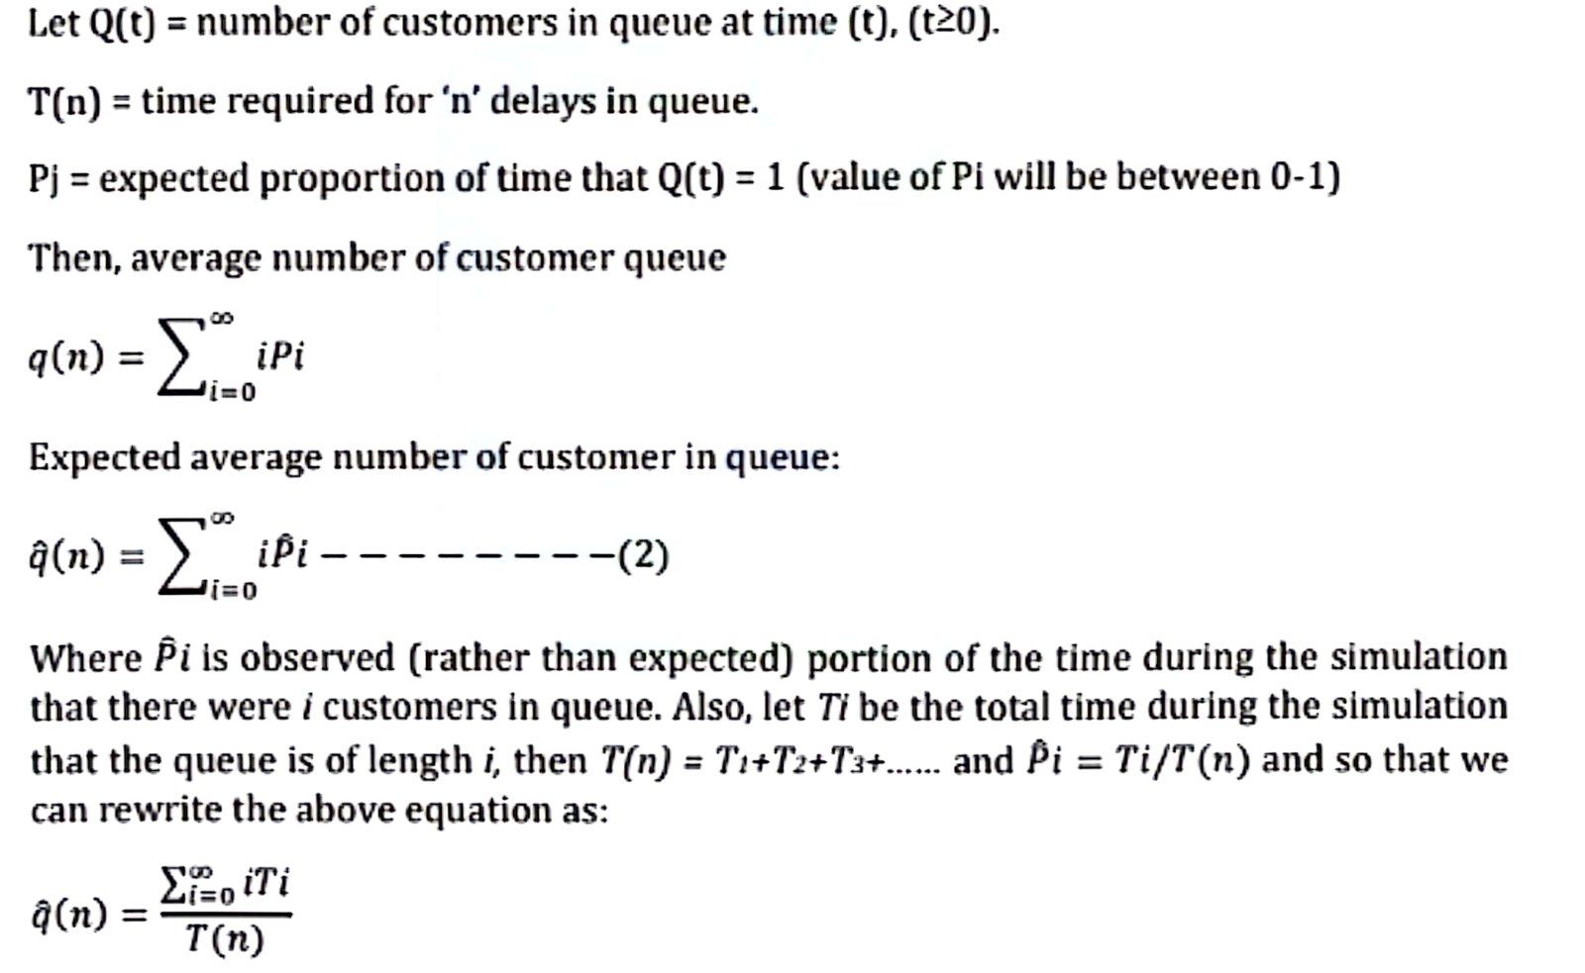


Slide 22
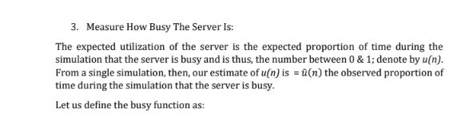
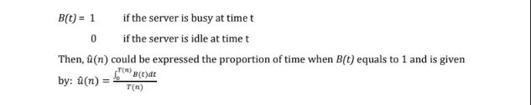

Slide 23
The knowledge of average number of customers in the queue or in the system helps to determine the space requirements of the waiting entities. Also too long a waiting line may discourage the prospectus customers, while no queue may suggest that service customers, while no queue may suggest that service offered is not of good quality to attract customers.
The knowledge of average waiting time in the queue is necessary for determining the cost of waiting in the queue
System Utilization
System Utilization that is the percentage capacity utilized reflects that extent to which the facility is busy rather than idle.
System utilization factor (s) is the ratio of average arrival rate ( λ) to the average service rate (µ).
S= λ / µ in the case of a single server model
S= λ/µn in the case of a “n” server model
The system utilization can be increased by increasing the arrival rate which amounts to increasing the average the arrival rate which amounts to increasing the average queue length as well as the average waiting time. Under the normal circumstances 100% system utilization is not a realistic

Slide 24
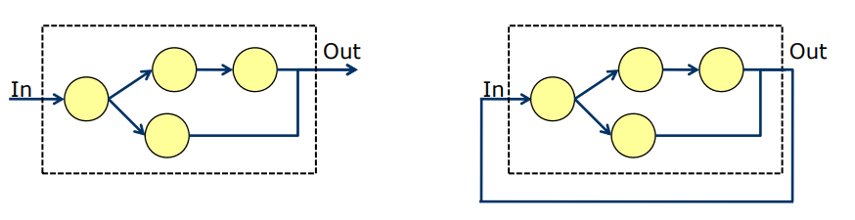
Networks of Queues
No simple notation for networks of queues
Queueing network is a collection of interconnected queues where customers/jobs move between service stations according to routing probabilities
Two types of networks of queues
Open queueing network
• External arrivals and departures
Number of customers in system varies over time
Closed queueing network
• No external arrivals and departures
• Number of customers in system is constant

Slide 25
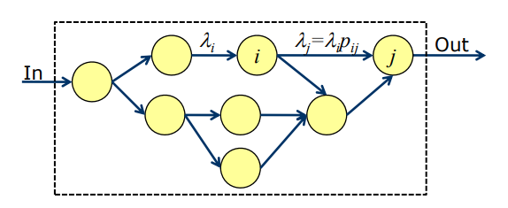
Networks of Queues
• Many systems are modeled as networks of single queues
• Customers departing from one queue may be routed to Another
The following results assume a stable system with infinite calling population and no limit on system capacity:
• Provided that no customers are created or destroyed in the queue, then the departure rate out of a queue is the same as the arrival rate into the queue, over the long run.
• If customers arrive to queue i at rate λi, and a fraction 0 ≤ p_{ij} ≤ 1 of them are routed to queue j upon departure, then the arrival rate from queue i to queue j is λ_{j} = λ_{i} p_{ij} over the long run.

Slide 26
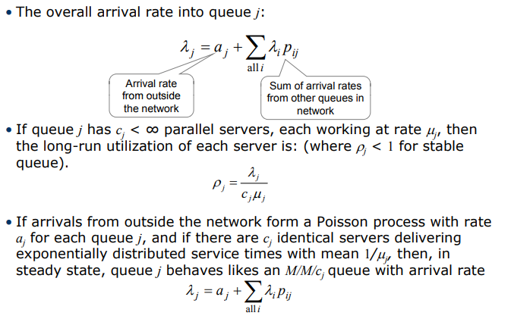
Networks of Queues

Slide 27
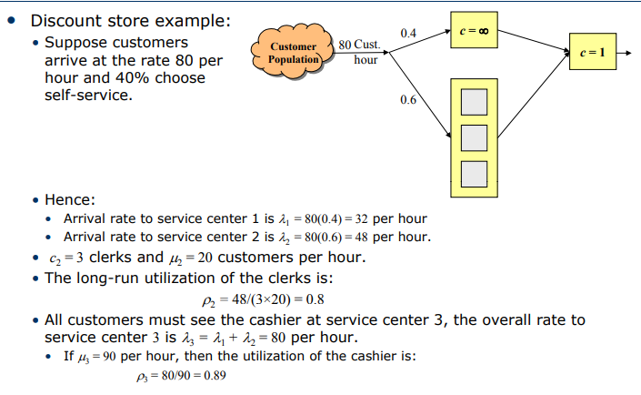
Networks of Queues

Slide 28
Applications of Queuing system
Telecommunications
Traffic control
Determining the sequence of computer operations
Predicting computer performance
Health services (eg. control of hospital bed assignments)
Airport traffic, airline ticket sales
Layout of manufacturing systems.
Example in many retail stores and banks In many retail stores and banks
multiple line/multiple checkout system a queuing system where customers wait for the next available cashier
We can prove using queuing theory that : throughput improves increases when queues are used instead of separate lines

Slide 29
Markov chain
A Markov process is a stochastic process that satisfies the Markov property (sometimes characterized as "memorylessness"). In simpler terms, it is a process for which predictions can be made regarding future outcomes based solely on its present state and—most importantly—such predictions are just as good as the ones that could be made knowing the process's full history. In other words, conditional on the present state of the system, its future and past states are independent.
A Markov chain is a type of Markov process that has either a discrete state space or a discrete index set (often representing time), but the precise definition of a Markov chain varies.For example, it is common to define a Markov chain as a Markov process in either discrete or continuous time with a countable state space (thus regardless of the nature of time),but it is also common to define a Markov chain as having discrete time in either countable or continuous state space (thus regardless of the state space).
A discrete-time Markov chain is a sequence of random variables X₁, X₂, X₃, ... with the Markov property, namely that the probability of moving to the next state depends only on the present state and not on the previous states:
if both conditional probabilities are well defined, that is, if
The possible values of Xi form a countable set S called the state space of the chain.

Slide 30
Transitions
The changes of state of the system are called transitions. The probabilities associated with various state changes are called transition probabilities. The process is characterized by a state space, a transition matrix describing the probabilities of particular transitions, and an initial state (or initial distribution) across the state space. By convention, we assume all possible states and transitions have been included in the definition of the process, so there is always a next state, and the process does not terminate.
Visualizing with an Example
a simple weather system where:
If today is Sunny, there is an 80% chance it is sunny tomorrow and
If today is Rainy, there is a 40% chance it is sunny tomorrow
An insurance company classifies drivers as low risk if they are accident free for one year Pust record indicate that 98% of the drivers in the low risk category i will remain in that category the next year, and 78% of the drivers who are not in the low risk category (L) one year will be in the low-risk category the next year.
If 90% of the drivers in the community are in the low-risk category this year, what is the probability that a driver chosen at random from the community will be in the low-risk category the next year? The year after next ?

Slide 31
Example
In the Dark Ages, Harvard, Dartmouth, and Yale admitted only male students. Assume that, at that time 80 percent of the sons of Harvard men went to Harvard and the rest went to Yale, 40 percent of the sons of Yale men went to Yale, and the rest split evenly between Harvard and Dartmouth; and of the sons of Dartmouth men, 70 percent went to Dartmouth, 20% to harvard, and 10 percent to Yale. (i) Find the probability Harvard. (ii) Modify the above by assuming that the son of a Harvard man always went to Harvard. Again, find the probability that the grandson of a man from Harvard went to Harvard.
Assume that a man's profession can be classified as professional, skilled laborer, or unskilled laborer. Assume that, of the sons of professional men, 80 percent are professional, 10 percent are skilled laborers, and 10 percent are unskilled laborers. In the case of sons of skilled laborers, 60 percent are skilled laborers, 20 percent are professional, and 20 percent are unskilled. Finally, in the case of unskilled laborers, 50 percent of the sons are unskilled laborers, and 25 percent each are in the other two categories. Assume that every man has at least one son, and form a Markov chain by followin the profession of a randomly chosen son of a given famil through several generations. Set up the matrix transition probabilities. Find the probability that randomly chosen grandson of an unskilled laborer is professional man.

